Slide 1
LESSON 2
MEAN OF A SAMPLING DISTRIBUTION

Slide 2
At the end of this lesson, the learner should be able to
accurately compute for the mean of a sampling distribution; and
correctly solve problems involving the mean of a sample distribution.

Slide 3
What is the difference between a sampling distribution and a population distribution?
How do we compute for the mean of a sampling distribution and a population distribution?
How will you compare the means of a population and a sample?

Slide 4
How does the data evolved from time to time?
How is it impossible to store large data?
Do you think Statistics will play a very vital role in these large data? Why or why not?

Slide 5
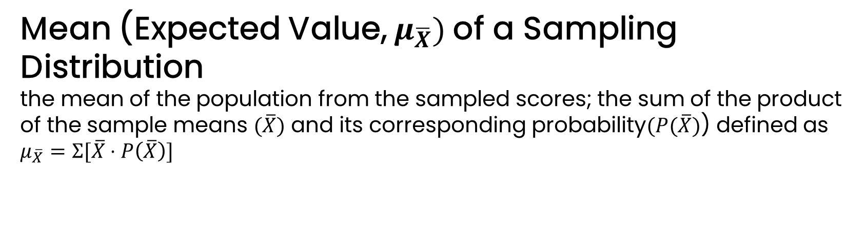
1
Mean (Expected Value, $μ_{\overline{X}})$of a Sampling Distribution
the mean of the population from the sampled scores; the sum of the product of the sample means $(\overline{X})$ and its corresponding probability$(P(\overline{X})$) defined as
$$μ_{\overline{X}}=Σ[\overline{X}⋅P\left(\overline{X}\right)]$$
Example:
Determine the mean of the sampling distribution of the given table below.
Sample Mean | Frequency | Probability
4 | 1 | 0.1
6 | 1 | 0.1
8 | 2 | 0.2
10 | 2 | 0.2
12 | 2 | 0.2
14 | 1 | 0.1
16 | 1 | 0.1

Slide 6
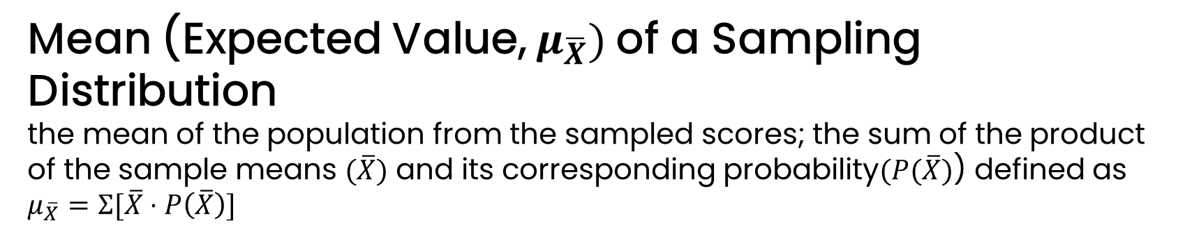
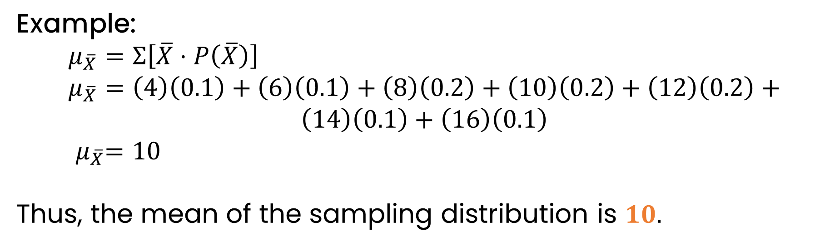
1
Mean (Expected Value, $μ_{\overline{X}})$of a Sampling Distribution
the mean of the population from the sampled scores; the sum of the product of the sample means $(\overline{X})$ and its corresponding probability$(P(\overline{X})$) defined as
$$μ_{\overline{X}}=Σ[\overline{X}⋅P\left(\overline{X}\right)]$$
Example:
$$μ_{\overline{X}}=Σ\left[\overline{X}⋅P\left(\overline{X}\right)\right] \\ μ_{\overline{X}}=\left(4\right)\left(0.1\right)+\left(6\right)\left(0.1\right)+\left(8\right)\left(0.2\right)+\left(10\right)\left(0.2\right)+\left(12\right)\left(0.2\right)+$$
$$\left(14\right)\left(0.1\right)+\left(16\right)\left(0.1\right)$$
$${ μ}_{\overline{X}}=10$$
Thus, the mean of the sampling distribution is $10.$

Slide 7

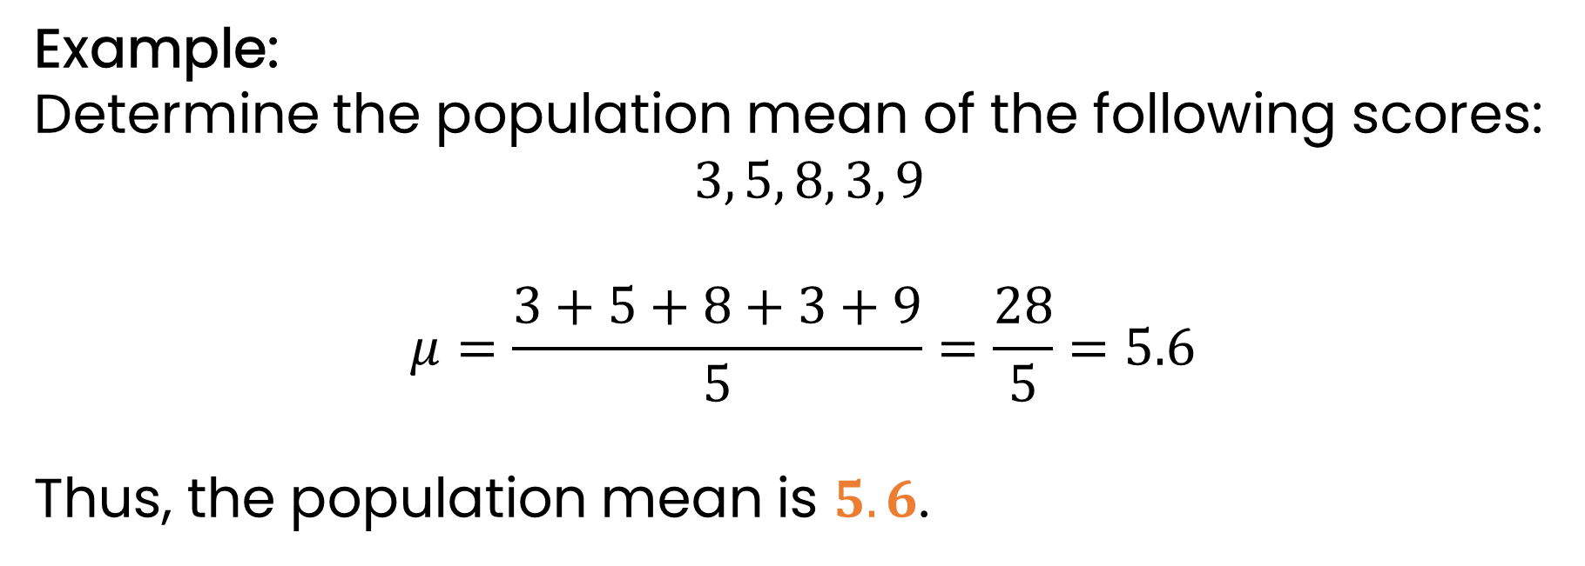
2
Population Mean
the average of all the scores in the population denoted by $μ$
Example:
Determine the population mean of the following scores:
$3, 5, 8, 3, 9$
$$μ=\frac{3+5+8+3+9}{5}=\frac{28}{5}=5.6$$
Thus, the population mean is $5.6$.

Slide 8
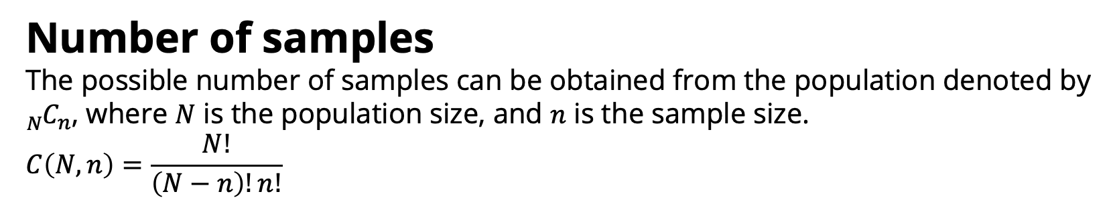
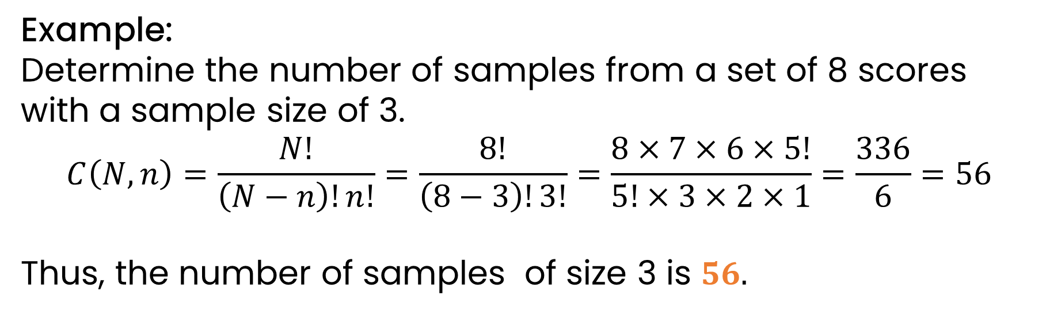
3
Number of samples
The possible number of samples can be obtained from the population denoted by ${{}_{N}^{ }C}_{n}$, where $N$ is the population size, and $n$ is the sample size.
$$C\left(N,n\right)=\frac{N!}{\left(N−n\right)!n!}$$
Example:
Determine the number of samples from a set of 8 scores with a sample size of 3.
$$C\left(N,n\right)=\frac{N!}{\left(N−n\right)!n!}=\frac{8!}{\left(8−3\right)!3!}=\frac{8×7×6×5!}{5!×3×2×1}=\frac{336}{6}=56$$
Thus, the number of samples of size 3 is $56.$

Slide 9
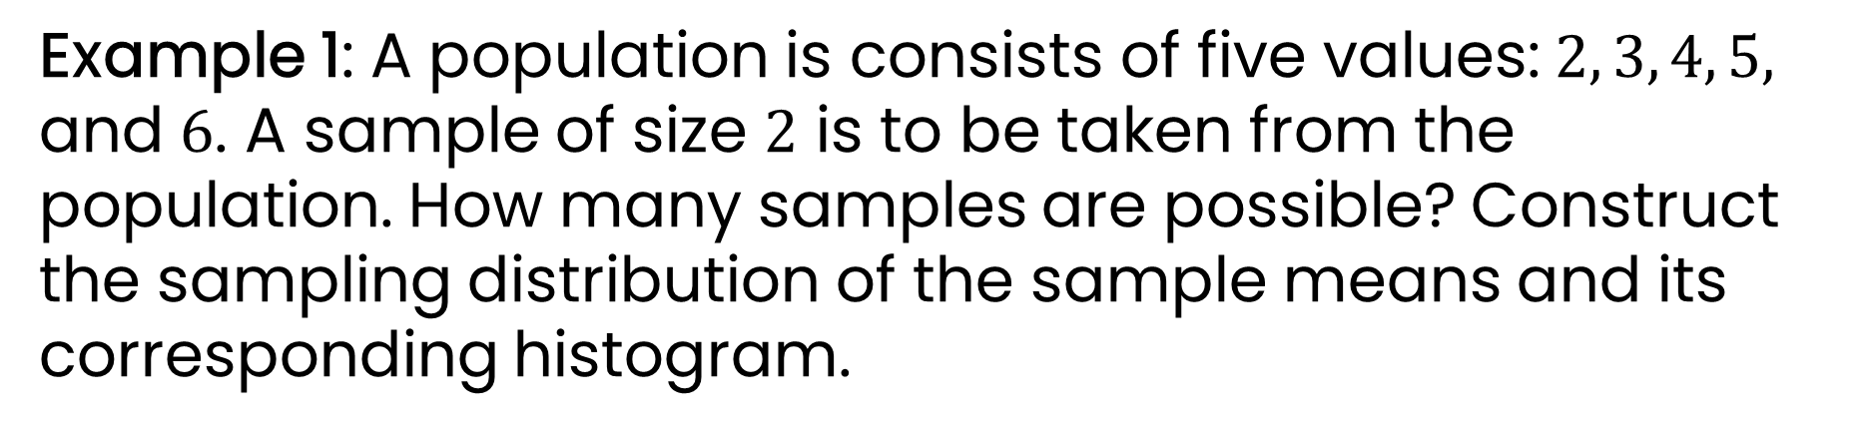
Example 1: A population is consists of five values:$2, 3, 4, 5,$ and $6$. A sample of size $2$ is to be taken from the population. How many samples are possible? Construct the sampling distribution of the sample means and its corresponding histogram.

Slide 10
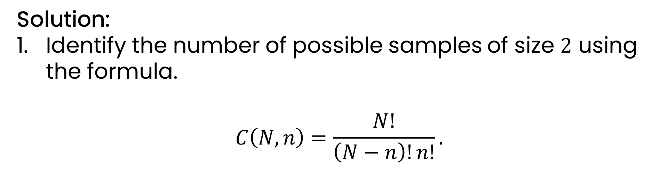
Solution:
Identify the number of possible samples of size $2$ using the formula.
$$C\left(N,n\right)=\frac{N!}{\left(N−n\right)!n!}.$$

Slide 11
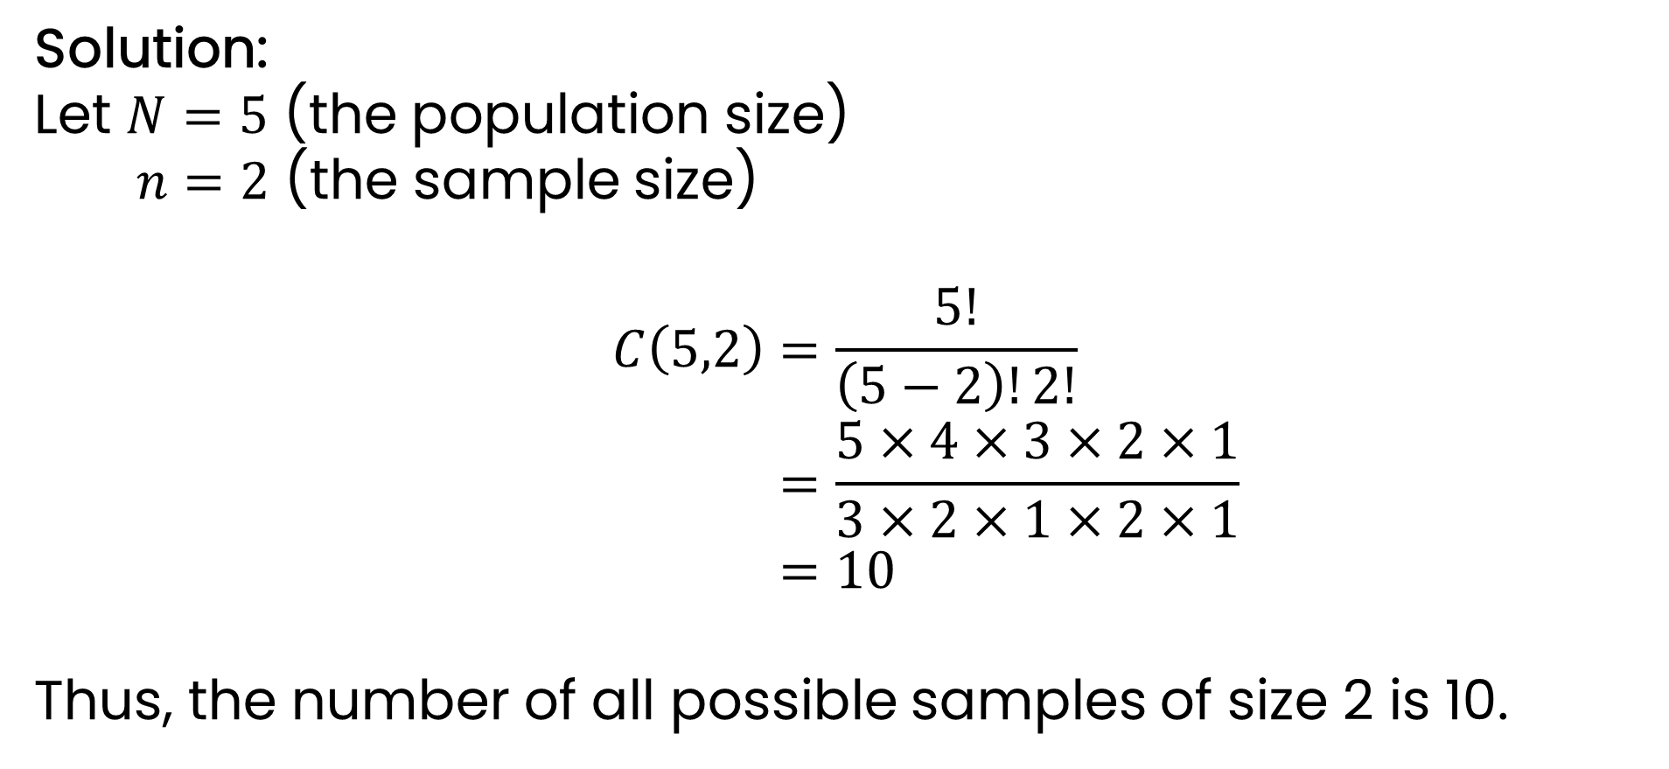
Solution:
Let $N=5$ (the population size)
$n=2$ (the sample size)
$$C\left(5,2\right)=\frac{5!}{\left(5−2\right)!2!} \\ =\frac{5×4×3×2×1}{3×2×1×2×1} \\ =10$$
Thus, the number of all possible samples of size 2 is 10.

Slide 12
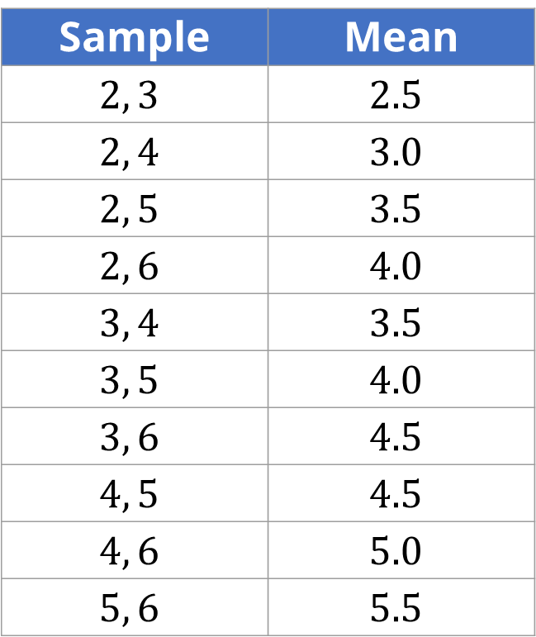
Solution:
List all possible samples of the indicated size and its corresponding mean in a tabular form.
Sample | Mean
$$2, 3$$ | $$2.5$$
$$2, 4$$ | $$3.0$$
$$2, 5$$ | $$3.5$$
$$2, 6$$ | $$4.0$$
$$3, 4$$ | $$3.5$$
$$3, 5$$ | $$4.0$$
$$3, 6$$ | $$4.5$$
$$4, 5$$ | $$4.5$$
$$4, 6$$ | $$5.0$$
$$5, 6$$ | $$5.5$$

Slide 13
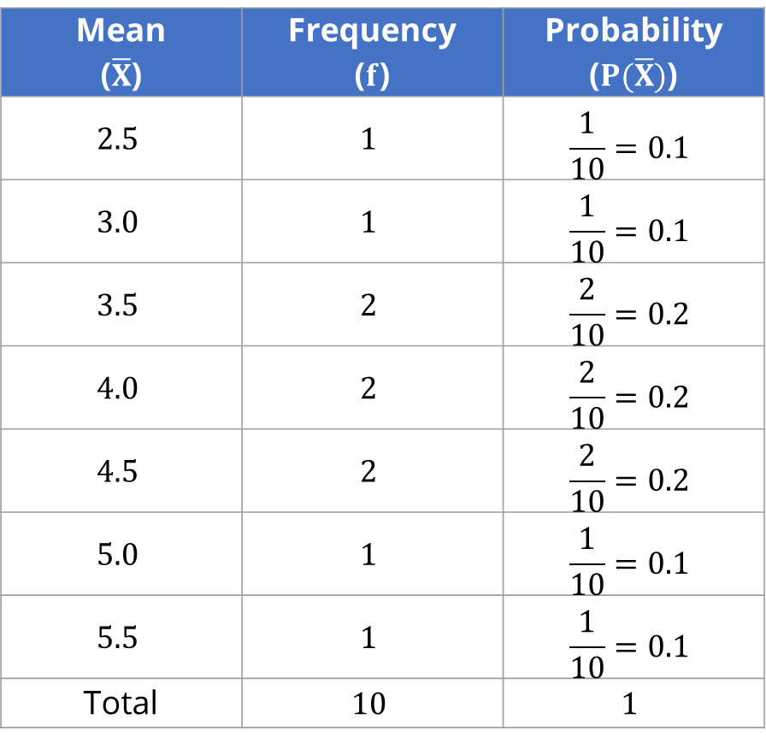
Solution:
Construct the sampling distribution of the sample means.
Mean ($\overline{X}$) | Frequency ($f$) | Probability ($P(\overline{X})$)
$$2.5$$ | $$1$$ | $$\frac{1}{10}=0.1$$
$$3.0$$ | $$1$$ | $$\frac{1}{10}=0.1$$
$$3.5$$ | $$2$$ | $$\frac{2}{10}=0.2$$
$$4.0$$ | $$2$$ | $$\frac{2}{10}=0.2$$
$$4.5$$ | $$2$$ | $$\frac{2}{10}=0.2$$
$$5.0$$ | $$1$$ | $$\frac{1}{10}=0.1$$
$$5.5$$ | $$1$$ | $$\frac{1}{10}=0.1$$
Total | $$10$$ | $$1$$

Slide 14
Solution:
4. Create a histogram.

Slide 15
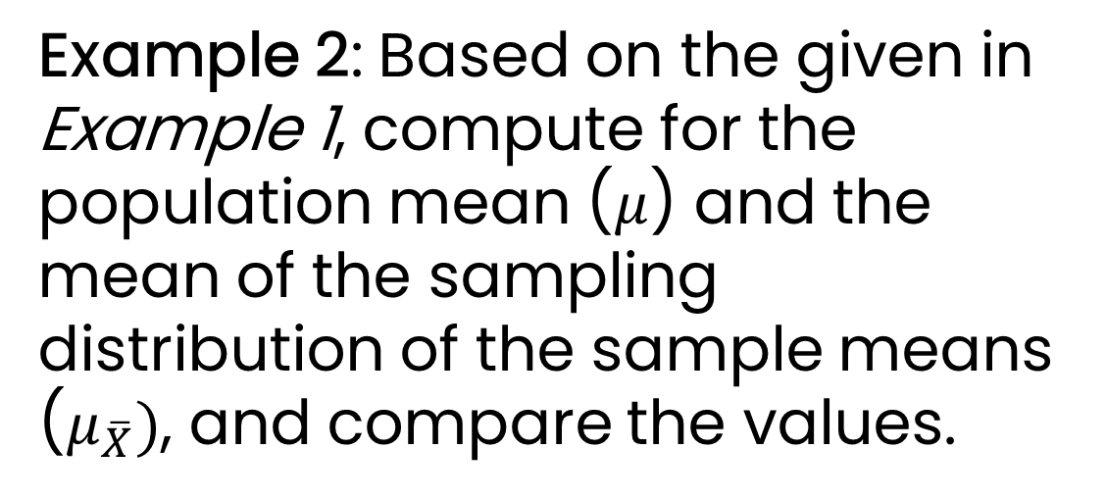
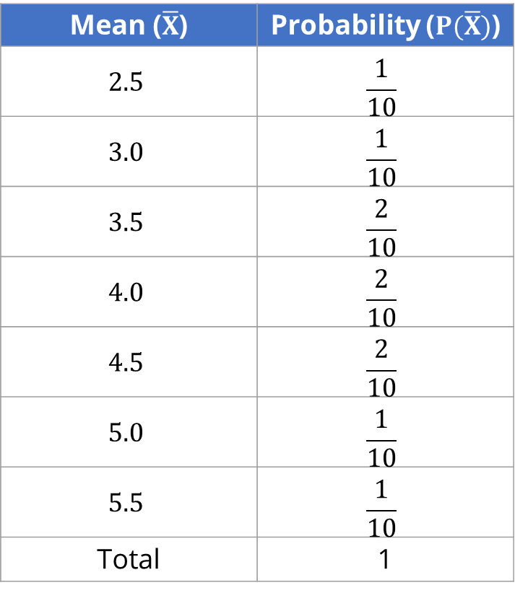
Example 2: Based on the given in Example 1, compute for the population mean ($μ$) and the mean of the sampling distribution of the sample means ($μ_{\overline{X}})$, and compare the values.
Mean ($\overline{X}$) | Probability ($P(\overline{X})$)
$$2.5$$ | $$\frac{1}{10}$$
$$3.0$$ | $$\frac{1}{10}$$
$$3.5$$ | $$\frac{2}{10}$$
$$4.0$$ | $$\frac{2}{10}$$
$$4.5$$ | $$\frac{2}{10}$$
$$5.0$$ | $$\frac{1}{10}$$
$$5.5$$ | $$\frac{1}{10}$$
Total | 1

Slide 16
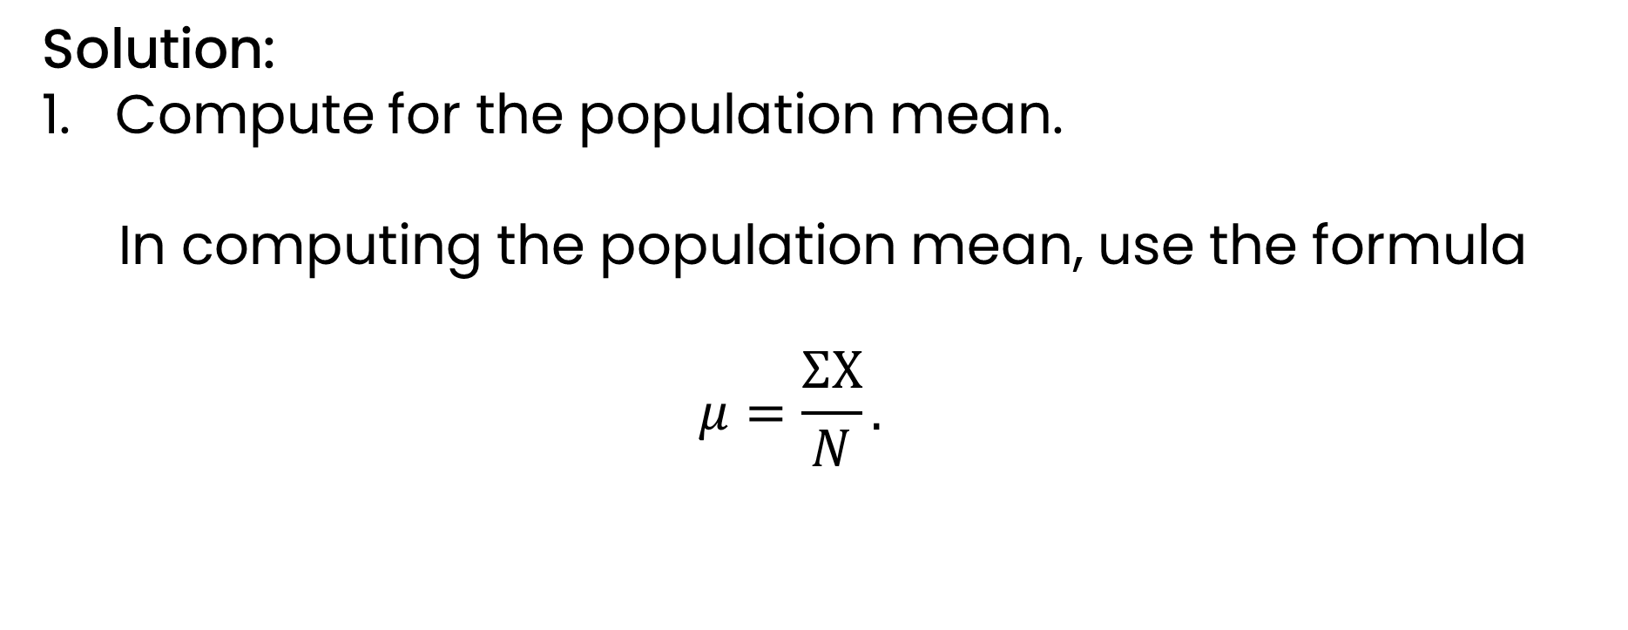
Solution:
Compute for the population mean.
In computing the population mean, use the formula
$$μ=\frac{ΣX}{N}.$$

Slide 17
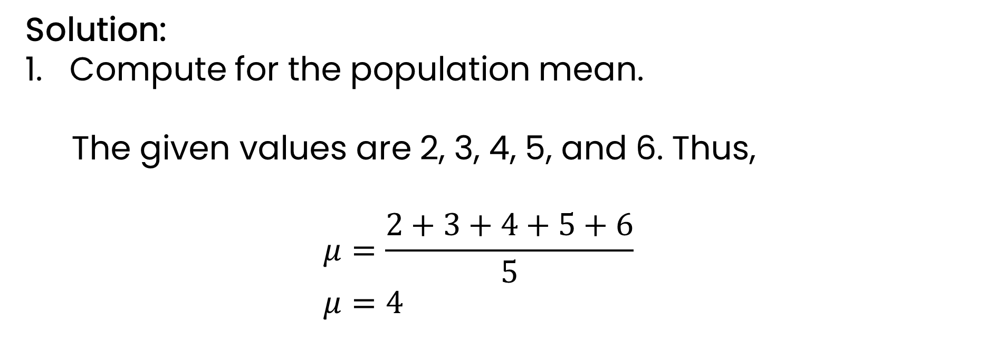
Solution:
Compute for the population mean.
The given values are 2, 3, 4, 5, and 6. Thus,
$$μ=\frac{2+3+4+5+6}{5} \\ μ=4$$

Slide 18
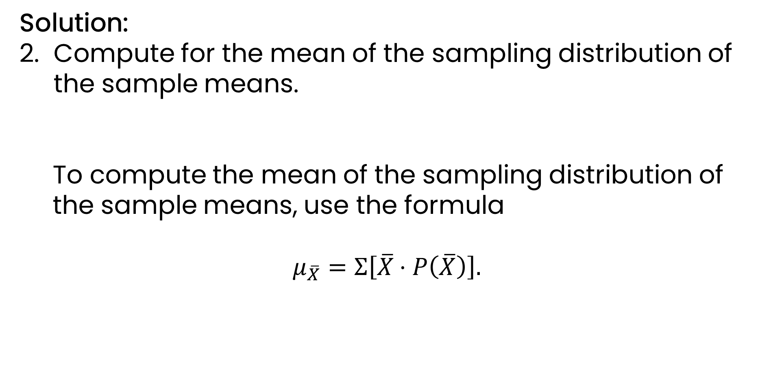
Solution:
Compute for the mean of the sampling distribution of the sample means.
To compute the mean of the sampling distribution of the sample means, use the formula
$$μ_{\overline{X}}=Σ\left[\overline{X}⋅P\left(\overline{X}\right)\right].$$

Slide 19
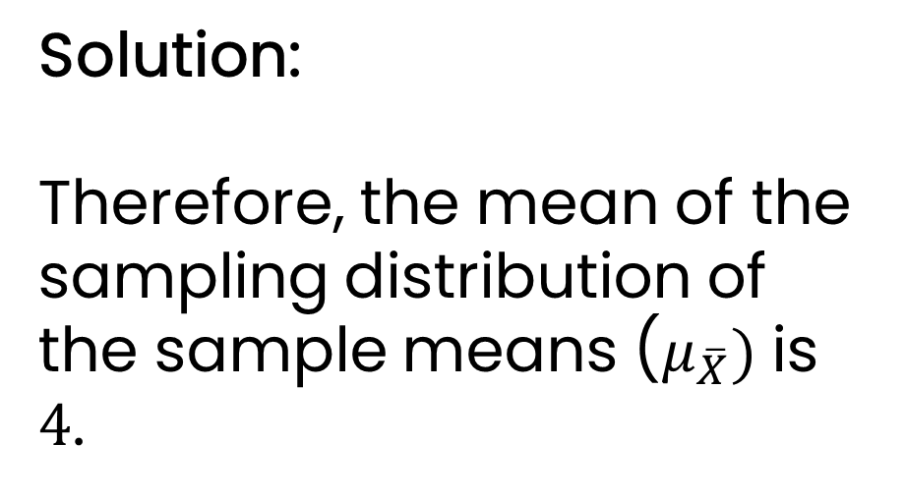
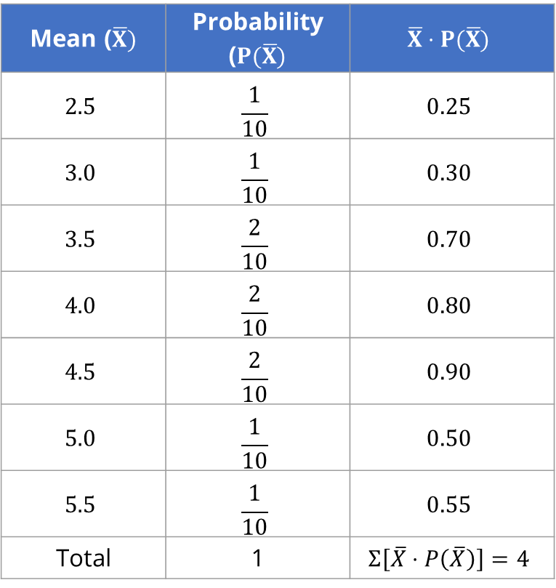
Solution:
Therefore, the mean of the sampling distribution of the sample means ($μ_{\overline{X}})$ is $4$.
Mean ($\overline{X})$ | Probability ($P(\overline{X})$ | $$\overline{X}⋅P(\overline{X})$$
$$2.5$$ | $$\frac{1}{10}$$ | $$0.25$$
$$3.0$$ | $$\frac{1}{10}$$ | $$0.30$$
$$3.5$$ | $$\frac{2}{10}$$ | $$0.70$$
$$4.0$$ | $$\frac{2}{10}$$ | $$0.80$$
$$4.5$$ | $$\frac{2}{10}$$ | $$0.90$$
$$5.0$$ | $$\frac{1}{10}$$ | $$0.50$$
$$5.5$$ | $$\frac{1}{10}$$ | $$0.55$$
Total | 1 | $$Σ\left[\overline{X}⋅P\left(\overline{X}\right)\right]=4$$

Slide 20
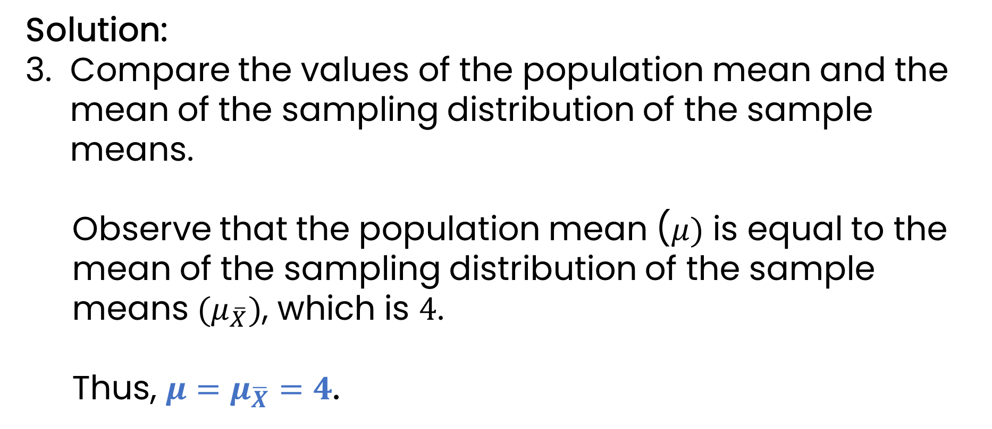
Solution:
Compare the values of the population mean and the mean of the sampling distribution of the sample means.
Observe that the population mean ($μ)$ is equal to the mean of the sampling distribution of the sample means ${(μ}_{\overline{X}})$, which is $4$.
Thus, $μ=μ_{\overline{X}}=4$.

Slide 21
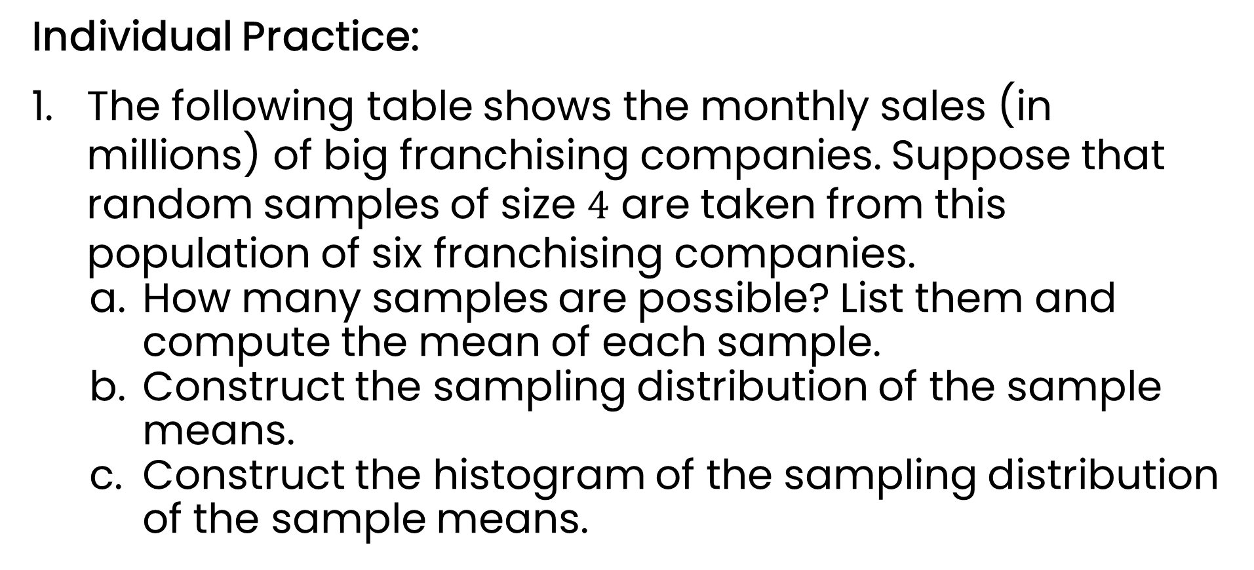
Individual Practice:
The following table shows the monthly sales (in millions) of big franchising companies. Suppose that random samples of size $4$ are taken from this population of six franchising companies.
How many samples are possible? List them and compute the mean of each sample.
Construct the sampling distribution of the sample means.
c. Construct the histogram of the sampling distribution of the sample means.

Slide 22
Individual Practice:
Company | Sales (in Millions)
X | 8
Y | 12
Z | 16
S | 20
T | 24
U | 28

Slide 23
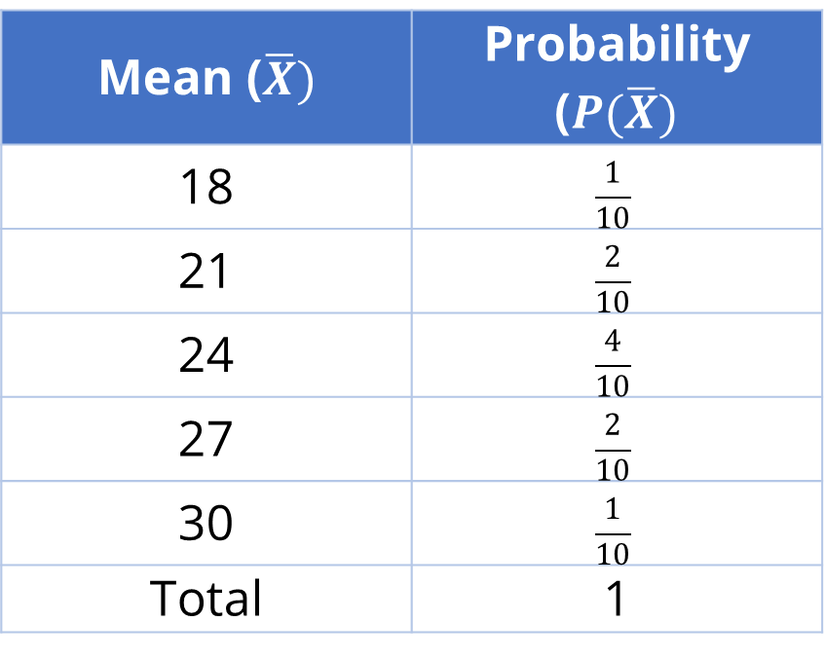
Individual Practice:
2. Compute for the mean of the sampling distribution of the sample means given on the right and compare the value to the population mean computed as 24.
Mean ($\overline{X})$ | Probability ($P(\overline{X})$
18 | $$\frac{1}{10}$$
21 | $$\frac{2}{10}$$
24 | $$\frac{4}{10}$$
27 | $$\frac{2}{10}$$
30 | $$\frac{1}{10}$$
Total | 1

Slide 24
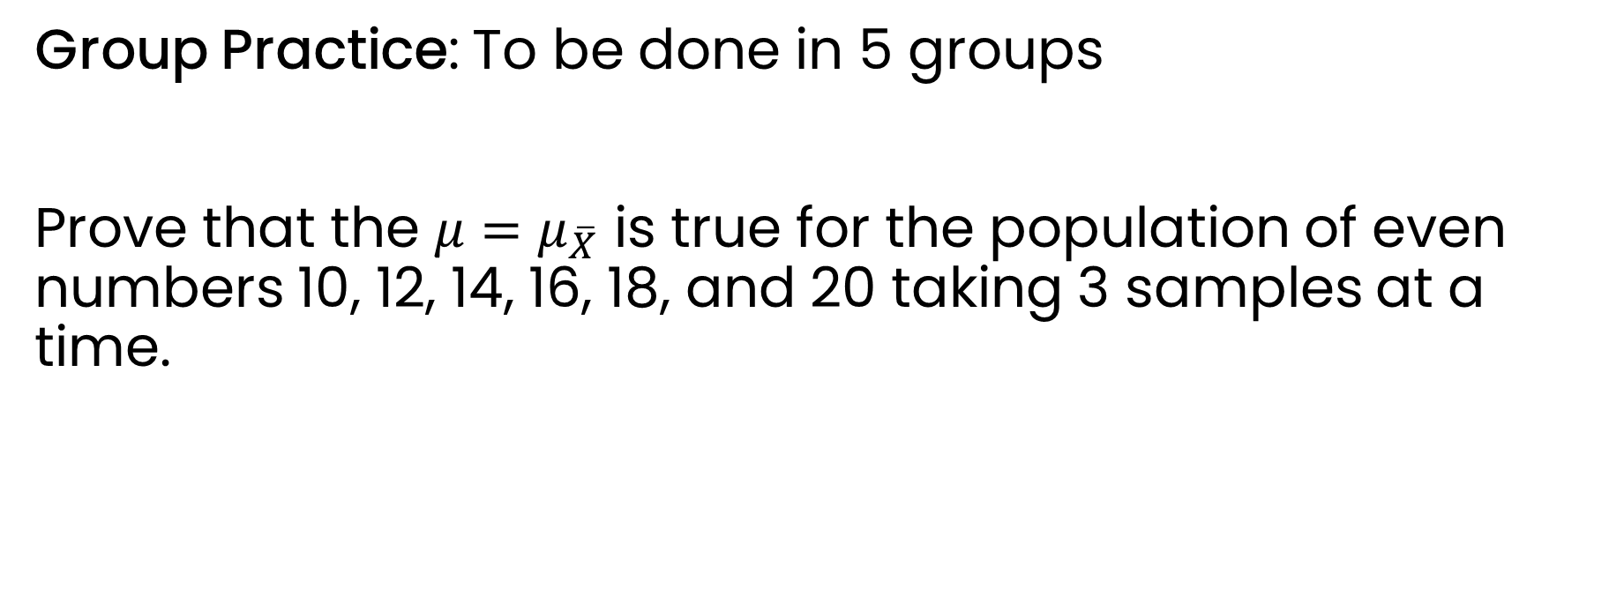
Group Practice: To be done in 5 groups
Prove that the $μ=μ_{\overline{X}}$ is true for the population of even numbers 10, 12, 14, 16, 18, and 20 taking 3 samples at a time.

Slide 25
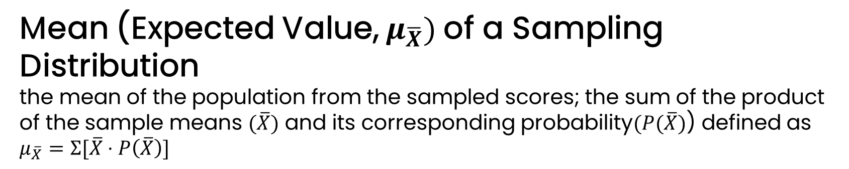

1
Mean (Expected Value, $μ_{\overline{X}})$of a Sampling Distribution
the mean of the population from the sampled scores; the sum of the product of the sample means $(\overline{X})$ and its corresponding probability$(P(\overline{X})$) defined as
$$μ_{\overline{X}}=Σ[\overline{X}⋅P\left(\overline{X}\right)]$$
2
Population Mean
the average of all the scores in the population denoted by $μ$

Slide 26
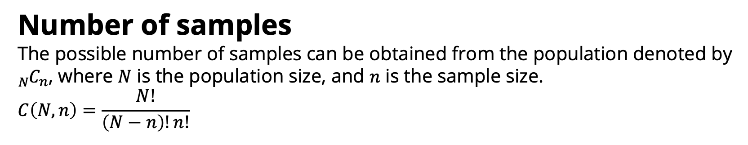
3
Number of samples
The possible number of samples can be obtained from the population denoted by ${{}_{N}^{ }C}_{n}$, where $N$ is the population size, and $n$ is the sample size.
$$C\left(N,n\right)=\frac{N!}{\left(N−n\right)!n!}$$

Slide 27
How do we compute for the mean of a sampling distribution?
Why do think it is important to discover that the population mean is equal to the mean of the sampling distribution of the sample means?
What is the relationship of a population standard deviation to a sample standard deviation?

